Slide 1
Global Marketing
Management
A European Perspective
Product and Service Decisions
Warren J. Keegan
Bodo B. Schlegelmilch

Slide 2
Product and Services: Important Concepts
Product
Service
Characteristics of Services
National, International, Global Products and Services
Global Brand
Positioning
Country of Origin Effects

Slide 3
Basic Concept of Products
Products can be defined as a collection of physical, psychological and symbolic attributes that can collectively yield satisfaction, or benefit, to a buyer or user.
Products can also be defined by intangible attributes
Products can be classified into consumer and industrial goods
Products can be classified by the way their are purchased or their life-span

Slide 4
Basic Concept of Services
Service can be defined as intangible benefits purchased by customers that do not involve ownership
Characteristics:
  Intangibility
  Perishability
  Variability
  Simultaneous Production and Consumption

Slide 5
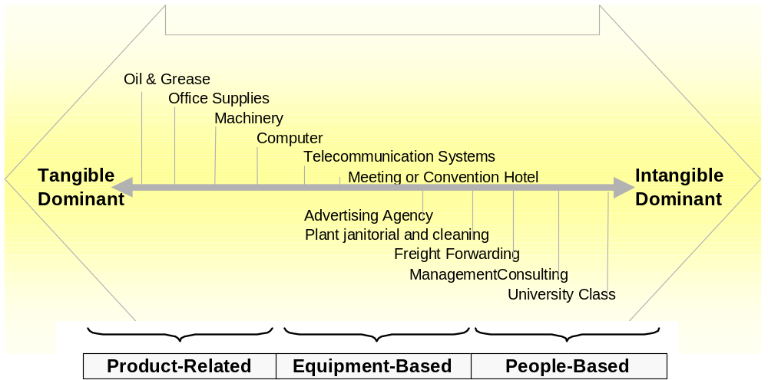
Product-Service Continuum

Slide 6
National, International and Global Products and Services
National products or services are offered in a single national Market
International products or services are offered in multinational, regional markets
Global products and services are offered in the global market. They are international and multiregional

Slide 7
Positioning of Products and Services
Attribute or Benefit
Quality/Price
Use/User
High-Tech Positioning
High-Touch Positioning

Slide 8
Product Saturation Levels in Global Markets
Many factors determine a product`s market potential
Product saturation level increases as national income per capita increases
The presence or absence of a particular companion product can be significant

Slide 9
Product and Service Design Considerations
Preferences
Costs
Laws and Regulations
Compatibility

Slide 10
Attitude towards the Country of Origin
Stereotyped attitudes toward foreign products and services can favour or hinder marketing efforts
If the quality is perceived to be low
  Foreign origin of the product can be disguised
  Foreign identification of the product can be continued and consumer attitudes towards the product can be changed
In some market segments foreign products have a substantial advantage because they are foreign

Slide 11
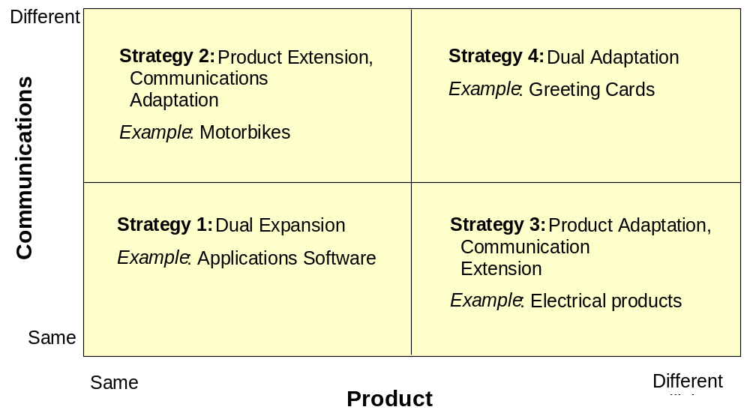
Geographic Expansion-Strategic Alternatives

Slide 12
Strategy 1: Product/Communication Extension (Dual Expansion)
Company sells exactly the same product or service with the same advertising as used in the home country
Company assumes that all markets are alike
Dual Extension does not work in all markets
Dual Extension is often used because it saves costs
Example: Campbell Soup

Slide 13
Strategy 2: Product Extension, Communications Adaptation
If the product serves different needs in various countries, only marketing communication may have to be adapted
Adaptation can happen by design or accident
Cheap implementation because product does not change
Example: Motorbikes

Slide 14
Strategy 3: Product Adaptation, Communication Extension
Product is adapted to the new market, but basic home market communication strategy remains unchanged
Product is adapted to the environment and the preferences of the consumers in the new market
Example: Mueslix

Slide 15
Strategy 4: Product/Communication Adaptation (Dual Adaptation)
Using Dual Adaptation the company must adapt the product or service as well as the marketing communication to the foreign market
Example: Colgate

Slide 16
New Products and Services in Global Marketing (1)
New to consumer and company ( Product or service innovation)
New to consumer but not new to company (Product/service or line extension)
Not new to consumer but new to company (New product or service duplication)

Slide 17
New Products and Services in Global Marketing (2)
New-product development process
  Permanent identification of new-product ideas
  Screening of these ideas and identification of candidates for further investigation
  Stringent investigation and analysis of the selected new-product ideas
  Organisation of sufficient resources
The international new-product department
Testing new products and services in national markets

